Slide 1
Building Data-driven Canvas Apps
Notes:
This module teaches students the best practices for building data-driven canvas apps using connections, galleries, item templates, forms and data cards. Students will learn best practices for tracking application state using global variables, context variables and collections. The module introduces students to the principles of delegation and explains how to filter, sort and search through a large Azure SQL database tables and a large SharePoint lists without compromising performance. Students will learn how to build a user experience to add and update data using edit forms and data cards. The module concludes with an examination of the PowerApps integration feature with SharePoint Online which makes it possible to customize the SharePoint list forms to provide business users with an enhanced user experience for editing content in a SharePoint Online.

Slide 2
Agenda
Screen Design Guidelines
Displaying Repeating Data using Galleries
Using Table Functions to Filter and Sort Data
Updating Data using Edit Forms and Data Cards
Customizing SharePoint List Forms

Slide 3
Challenges with Building Canvas Apps
Who is the typical PowerApps application maker?
A developer without a software development background
What is the maker is responsible for?
designing, building, testing, deploying
What are the challenges in deploying canvas apps?
Building projects that are easy to maintain and extend
Building consistency across team members
Building canvas apps with better performance
Notes:
The features of PowerApps have been designed around the persona of the citizen developer. The core concept is that PowerApps has been designed to be accessible to business users without much background in software development or IT. But therein lies the rub. How can a person without any background in developing software build a large enterprise-level application that scales in terms of complexity and performance?
If you are planning to build applications with PowerApps to share at the departmental or organization level, you should learn to best practice techniques with respect to designing, building, testing, deploying canvas apps. When you work on a large project with many screens, you should make sure the project remains easy to maintain and extend. You should also strive to build consistency across team members using standardized techniques and naming conventions.

Slide 4
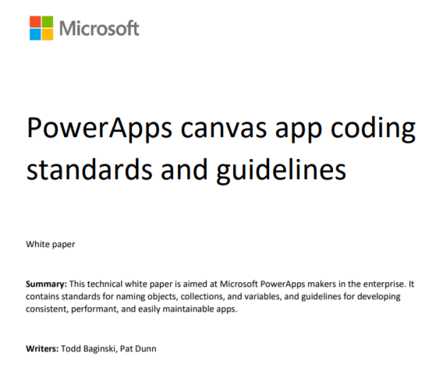


Read the Canvas Apps Whitepaper
PowerApps canvas app coding standards and guidelines https://powerapps.microsoft.com/en-us/blog/powerapps-canvas-app-coding-standards-and-guidelines/
As a builder, you should strive for…
Simplicity, Readability , Performance, Supportability, Accessibility
Ease of deployment and administration
Todd Baginski
Pat Dunn
Notes:
The whitepaper referenced on the slide is a great read. You should use it as a reference after this training course is over.

Slide 5
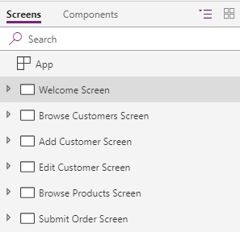
Creating Screen Names
It's import to create screen names correctly
Screen names will be read aloud by screen readers
Names should include spaces and avoid abbreviations
Screen name should end with the word "Screen"
Screen name should reflect purpose of screen
Notes:
There is very specific guidance for naming screens in a canvas app. This is due to the fact the that screen names are read aloud by a screen reader in scenarios where your canvas app is being accessed by a user that is hearing impaired. Screen names should include spaces, avoid abbreviations and be clearly worded to reflect purpose of screen. It is also an accepted best practice to end the name of a screen with the word "Screen".

Slide 6
Control Naming
Control names cannot be duplicated across screens
Control names must be unique throughout project
You should standardize on control naming convention
Use prefixes and make control names as self-explanatory
button | btn
camera control | cam
canvas | can
card | crd
collection | col
combo box | cmb
date picker | dte
drop down | drp
radio button | rad
form | frm
gallery | gal
group | grp
header page shape | fdr
html text | html
icon | ico
image | img
label | lbl
page section shape | sec
shapes (rectangle, etc.) | shp
table data | tbl
text input | txt
timer | tim
Notes:
Remember that canvas apps do not allow you to use the same name for two controls within the same project. That means control names cannot be duplicated across screens. When you copy and paste controls across screens, PowerApps Studio automatically changes the name of each copied control by adding a number on the end of its name to ensure it is unique.
There is an obvious benefit that derives from the rule that all control names must be unique. When writing control property formulas, you can reference any control on any screen.
A common practice is to add control name prefixes to indicate the type of control using the standard prefixes shown in the slide above. You should also avoid using abbreviations and make control names as self-explanatory.

Slide 7
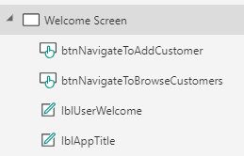
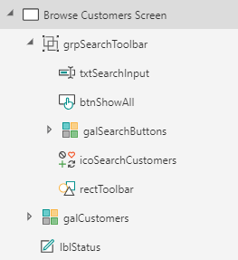
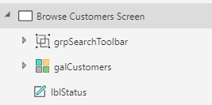
Keeping Screens Maintainable
Each control name should be easy to read & understand
Use grouping to isolate set of controls with single purpose
Expanded Group
Collapsed Group
Notes:
When you first begin building canvas apps, it might not be so obvious why control naming is important. However, when you have built a large canvas app with a dozen screens and hundreds of controls, you will see the benefits of creating control names that are easy to read and understand.
Another important technique managing for screens with a large number of controls is to group together controls that share a common purpose. When you select a set of controls and group them together using the Group command, the group can be renamed and collapsed. Once you have added a set of controls to a group, you can move them, hide them or show them all at once by adding formulas to group properties such as X, Y and Visible.

Slide 8
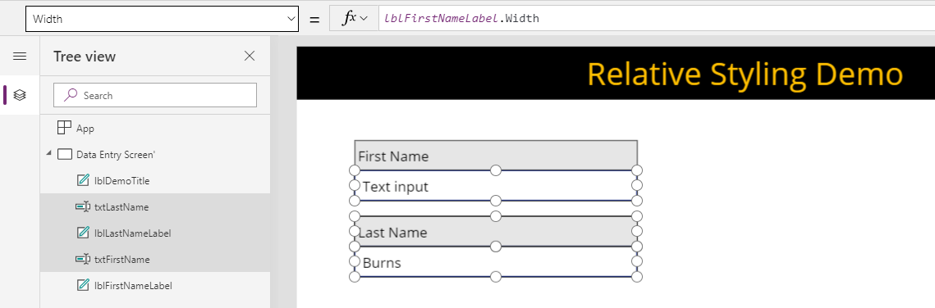
Relative Styling
Calculate control property values from other controls
Common to use properties like X, Y, Width, Height, Size, Fill, etc.
Notes:
When laying out controls on a form, it can be an effective technique to use relative styling where you write formulas for control properties that reference other control property values. After you have written the formulas that apply relative styling, you can make styling changes to a single control that are automatically applied to other controls that use relative styling. It is common to use relative styling with control properties such as X, Y, Width, Height, Size and Fill.
You can start experimenting with relative styling by creating a blank canvas app and adding a Label control and a Text input control. Write a formula for the X property of the Text input control to calculate its value using the X property value of the Label control. Do the same thing for several other Text input control properties including Width, Height, Size and Fill. Finally, write a formula for the Y property of the Text input control that calculates its value by adding the Y property value of the Label control together with the Label control Height property value so that Text input control is position just underneath the Label control.
Once you have set up these relative styling formulas, you should be able to able to move the Label control around the screen and change its width and height while the Text input control automatically responds to the changes in the Label control styling. You should also be able to change the font size and background fill color of the Label control and the Text input control should automatically adapt to changes in styling.

Slide 9
Designing Screens with Relative Styling

Slide 10
Agenda
Screen Design Guidelines
Displaying Repeating Data using Galleries
Using Table Functions to Filter and Sort Data
Updating Data using Edit Forms and Data Cards
Customizing SharePoint List Forms

Slide 11
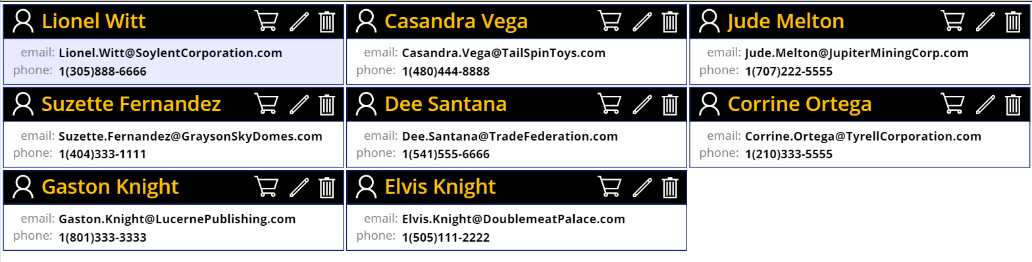
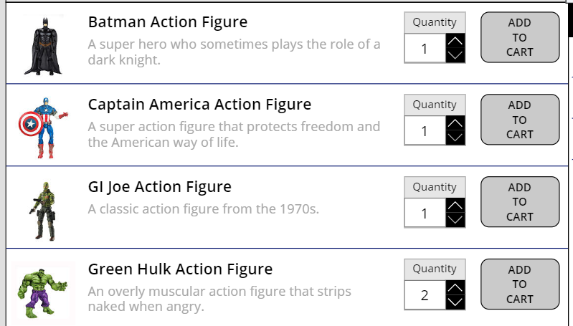
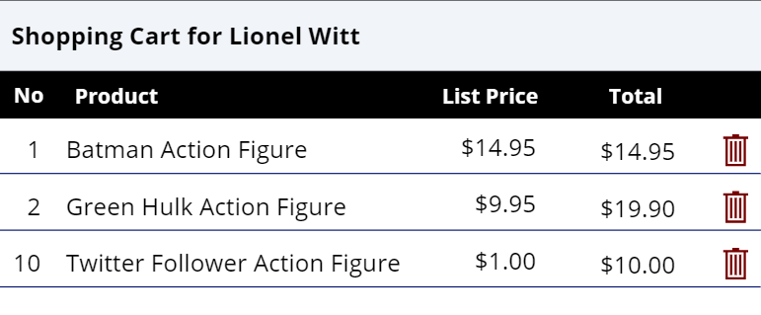
Displaying Repeating Items using Galleries
Galleries are used to display repeating items
A list of customers
A set of command buttons
A products list and a shopping cart
Notes:
If you are going to be building data-driven canvas apps, you must learn how to work with Gallery controls to display repeating data. A Gallery control has an Items property which references a underlying table. The Gallery control also contains an item template which is used to create a view that is repeated once for each record in the underlying table. This provides a very flexible and effective mechanism for display lists and tabular data.
You have several important choice to make when you create a gallery. Do you want to create a vertical gallery or a horizontal gallery. Do you want you gallery to display a single item per row or do you want to display multiple items per row. Will your gallery just display data in a read-only fashion or will it provide the user with editing capabilities or actions that can be applied to each item in the gallery.
In your upcoming lab exercise you will eb building a canvas app named Customer Ordering. As you move through the lab exercises, you will create galleries to display customer data and to build toolbar of search buttons. You will also use galleries to display a product list and to enable a shopping cart experience.

Slide 12
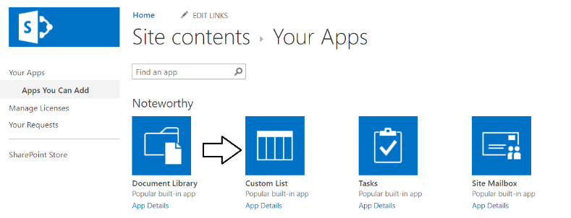
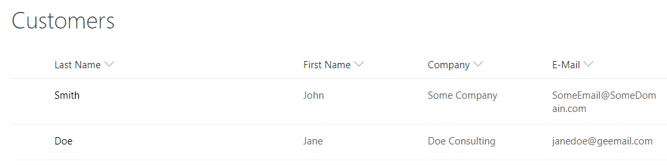
Creating Lists in SharePoint Online
PowerApps works best with modern lists
Best to create lists from the Custom list type
Add site columns to track required data
Notes:
You might be in a scenario where you will create a SharePoint list that will be accessed by a canvas app or a flow. When creating SharePoint lists that will be accessed by canvas apps and flows, it's best to avoid using the classic SharePoint list types such as Contacts, Tasks and Announcements. Instead, you should create new SharePoint lists using the generic Custom List type with the modern UI which integrates much better with PowerApps and Flow. Once you create a list from the Custom List type, you can then added standard site columns and create new site columns.
In the lab exercises associated with this training module, you will use the Custom List type to create a new SharePoint list named Customers. After that, you will add standard site columns so the list can track customer data including phone numbers, email addresses and physical addresses.

Slide 13
Creating galCustomers
Create a gallery to display customers
galCustomers created as a vertical gallery
Items property references Customers list in SharePoint
WrapCount property set to 3 to display three customers per row
Item template designed to display customer data
Item template designed to provide customer-specific actions
Notes:
In the upcoming lab, you will create a vertical gallery named galCustomers with a connection to the Customer list in SharePoint to display customers. You will set the WrapCount property to 3 so you can display multiple customers in each row of the gallery.
You will design the item template for galCustomers, you will add controls to display customer data. You will also add icons that will be used to provide customer-specific commands such as deleting a customer item or navigating to the edit screen for a specific customer.

Slide 14
Agenda
Screen Design Guidelines
Displaying Repeating Data using Galleries
Using Table Functions to Filter and Sort Data
Updating Data using Edit Forms and Data Cards
Customizing SharePoint List Forms

Slide 15
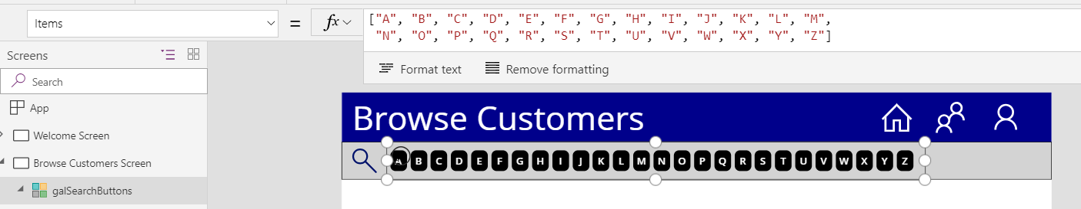
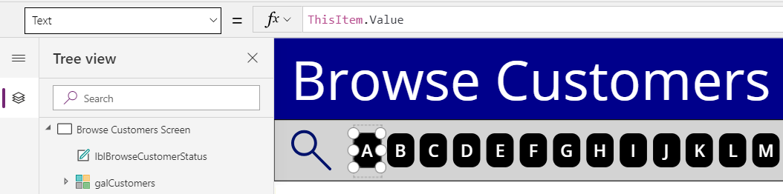
Creating galSearchButtons
Create a search toolbar
Assign table of letters to Items property of galSearchCustomers
Use ThisItem.Value for Text property of button inside gallery template
Notes:
When you build the Customer Ordering canvas app you will create a search toolbar which provides a search button for every letter in the alphabet. This will demonstrate the flexibility of using galleries.
You will start by creating a horizontal gallery named galSearchButtons. You will write a formula the gallery Items property to create a table with a Value column with a row for each letter in the alphabet Then you will design the item template with a single button control whose Text property has a formula of ThisItem.Value so each button displays a letter form the alphabet. After that, you must figure out how to add the appropriate behavior behind each button.

Slide 16
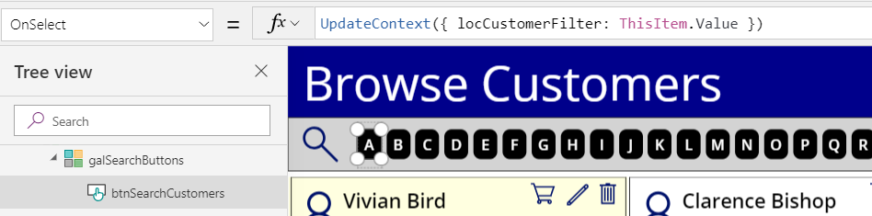
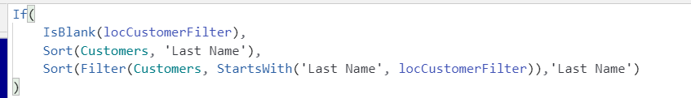
Creating a Search Filter
Assign filter string to local context variable
Configure expression for Items property to set filtering
Notes:
Implementing search behavior with the button in the galSearchButton gallery will require the use of a local context variable named locCustomerFilter. First, you will write a behavior formula for buttons in the gallery to assign a letter to locCustomerFilter. You will also add a Clear Filter button which sets the locCustomerFilter variable to a blank value.
Setting the value of the locCustomerFilter variable only provides half of the required implementation. The other half involves writing the formula for the Items property of galCustomers to filter customer data based on the value of locCustomerFilter. As you can see in the formula for the Items property shown in the slide above, you will use the Filter function to filter customer data only when the locCustomerFilter variable has a value that is not blank. Any time the user clicks one of the search button to update the value of the locCustomerFilter variable, gallery will automatically update to show the applied filtering.

Slide 17
Filtering Data in a Table

Slide 18
Agenda
Screen Design Guidelines
Displaying Repeating Data using Galleries
Using Table Functions to Filter and Sort Data
Updating Data using Edit Forms and Data Cards
Customizing SharePoint List Forms

Slide 19
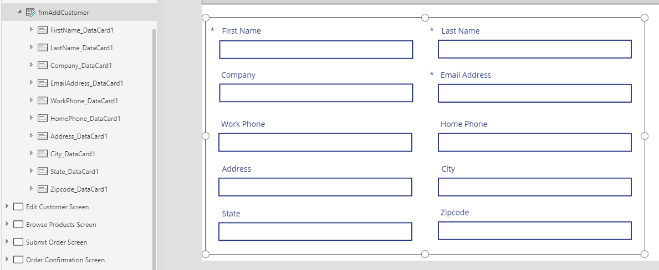
Working with Edit Forms and Data Cards
Form acts as a container for data cards
Each form binds to a single record
Within a form, each data card binds to an underlying field
Each data card contains an encapsulated set of child controls
Notes:
In PowerApps, you use display forms and edit forms for scenarios where you need to bind to a single record at a time. Display forms and edit forms act as containers that hold another type of control known as a 'data card’ which is also called a 'card control'. Each form contains a set of data cards that bind to individual fields from the underlying record. Each data card has a DataField property that determines which field it binds to within the underlying record.
A data card contains its own set of child controls. The child controls inside a data card make up the experience for displaying and editing a single field. For example, a number data card may consist of a Label control to provide the display name of the field and a Text input control to provide an editor for the value of the field. Most of the data cards supplied by PowerApps also provide a label control to display any validation errors that occur due to bad user input.
When you are writing a formula for a Form control property or a data card property, the current record is available using an object named ThisItem. The ThisItem object for a Form control contains properties for each field in the underlying record.
When you are writing a formula for the properties of a child control inside of a data card, you can use the Parent object. For example, a child control inside a data card should use Parent.Default to read the initial state of the field from the data source. By using the Parent object instead of directly accessing the information that you want, the data card is better encapsulated. That means you can use the same data card with multiple fields in the same record without breaking internal formulas.

Slide 20
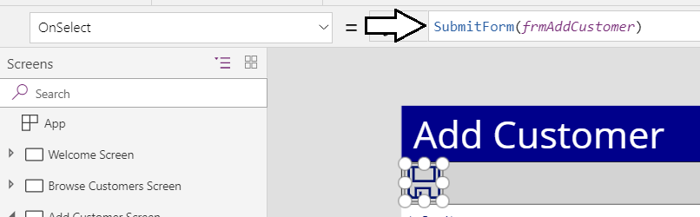
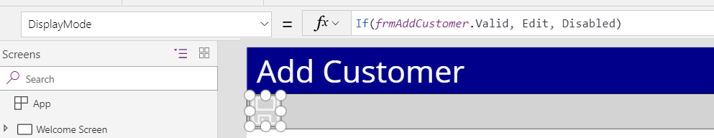
Form Submission with Edit Forms
Update with Edit Form triggered by calling SubmitForm
Submit button should be disabled when form data is not valid
Notes:
In order to save the data in an edit form with a new or existing record, you call the behavior function named SubmitForm. When this function executes, the PowerApps connector will write the changes back to the underlying data source. It works the exact same way regardless of whether the datasource is a SQL Server table, a SharePoint list or table in an Excel workbook in OneDrive for Business.
In most scenarios, you will be required to implement validation checks to ensure the user has correctly entered all the data needed to perform the update. You can begin by conditionally enabling or disabling the Save button according to a set of validation rules. You can do this by writing a formula for the Save button's DisplayMode property which disables the button when the Valid property of a Form control has a value of false.

Slide 21
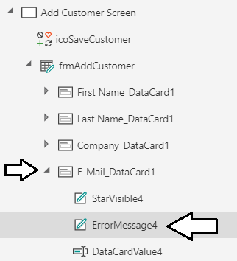
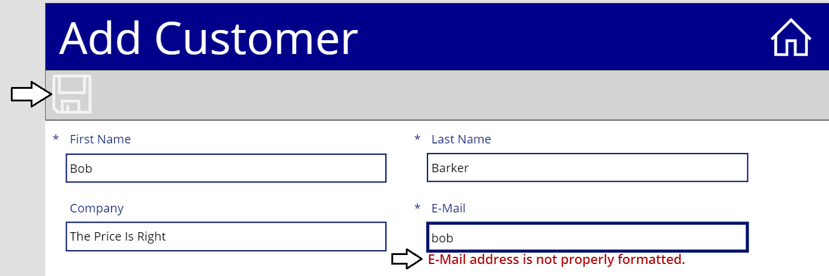
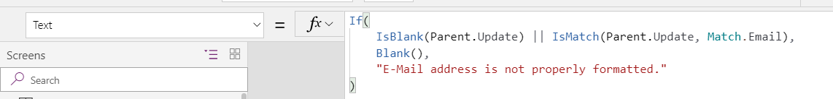
Custom Form Validation with Edit Forms
Data cards contain label control for error message
Set Text property of label to display error message
Notes:
The Valid property of a Form control provides a modest amount of validation support. The Valid property will be false until every field marked as a required field has a non-blank value. However, the Valid property of a Form cannot help you to add validation support for something such as an email address or a phone number.
If you need more complex validation support, you must customize a data card within a Form object. Most data cards contain an internal error label. You can write a formula for the error label to conditionally show an error message if the user input does not confirm to your validation rules. The formula on the slide above demonstrates how to display an error message for an email address that is not properly formatted.

Slide 22
Validating User Input Data with an Edit Form and Card Controls

Slide 23
Agenda
Screen Design Guidelines
Displaying Repeating Data using Galleries
Using Table Functions to Filter and Sort Data
Updating Data using Edit Forms and Data Cards
Customizing SharePoint List Forms

Slide 24
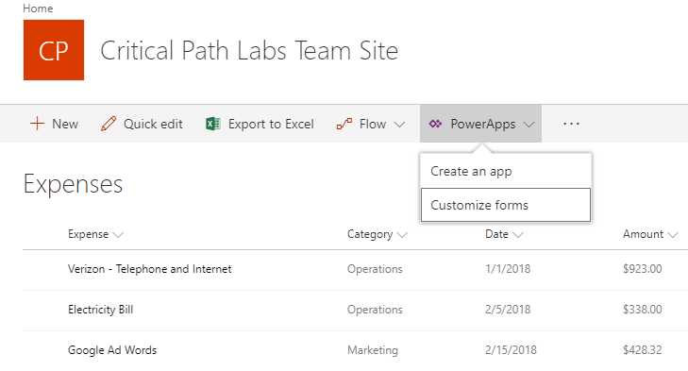
Customizing SharePoint List Forms
Modern SharePoint lists allow forms customization
Customized SharePoint lists provide custom UI using canvas apps
Notes:
In SharePoint Online, SharePoint lists can support the older classic UI as well as the new modern UI. When SharePoint lists are displayed using the new modern UI, there are commands to Create an app and to Customize forms. When you execute the Customize forms command on a SharePoint list, you will be redirected to a new canvas app in PowerApps Studio. The new canvas app will have a single screen with a Form control connected back to the SharePoint list.
If you go back 10 years in time, Microsoft positioned InfoPath as their the primary tools used to customize SharePoint Forms. However, Microsoft discontinued work on their InfoPath product around 2010 and, after that, there was a degree of uncertainty about what Microsoft recommended as the strategy for customizing forms in SharePoint Online. In 2018, Microsoft introduced support for customizing SharePoint list forms with PowerApps and begun recommending as the primary strategy for customizing forms in SharePoint Online

Slide 25
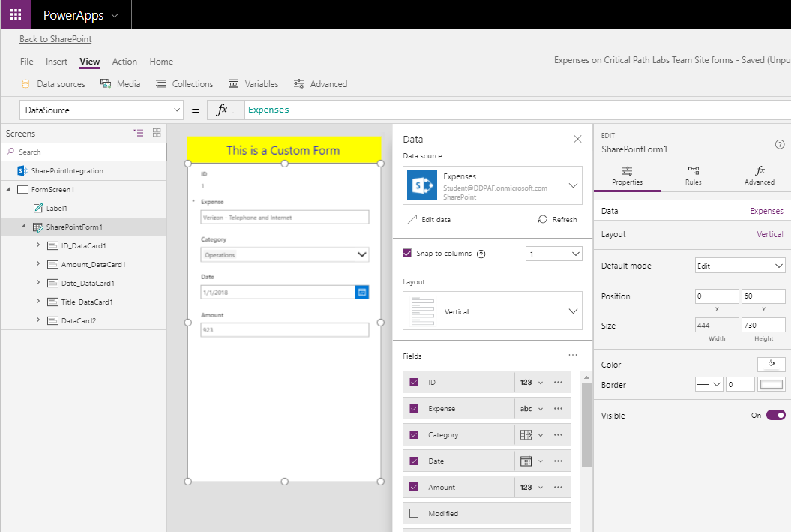
Customizing the Form
SharePoint list data passed in connection
Notes:
When you execute the Customize forms command on a SharePoint list, a new canvas app is automatically created. The canvas app is created with a single screen containing an Edit Form control. The Edit Form has a connection back to the SharePoint list and provides data cards allowing users to view and update column values when the form is in edit mode. You can add and remove SharePoint list columns from the form just as you would for any other Form in PowerApps Studio.
Note that the canvas app created when you execute the Customize forms command contains a single Edit Form control that is used in all three scenarios including (1) view item, (2) add new item and (3) edit existing item. In scenarios where you need more control, it is possible to create a separate screen and Form control for each of these three scenarios.

Slide 26
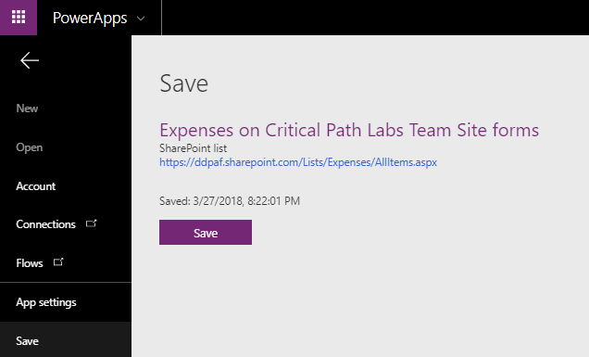
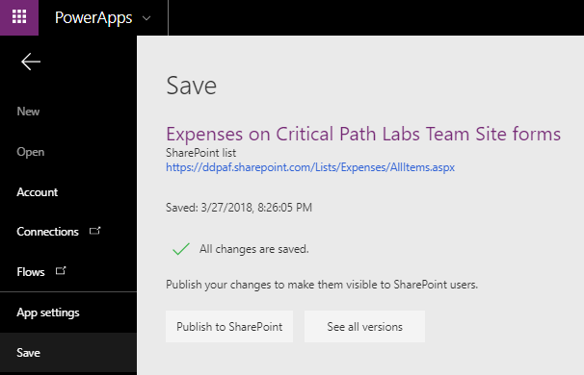
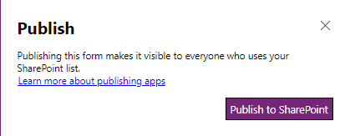
Saving the Customized Form
Canvas app is saved back into SharePoint site
Notes:
When you save the canvas app associated with a customized SharePoint list, it is saved back into the context of a SharePoint list. However, saving the canvas app does not actually activate it. It simply saves the canvas app back to the Microsoft cloud so you don't lose your work.
In order to activate the customized forms for a SharePoint list, you must execute the Publish to SharePoint command. Once you execute this command, You should be able to then view the customized form in the SharePoint UI.

Slide 27
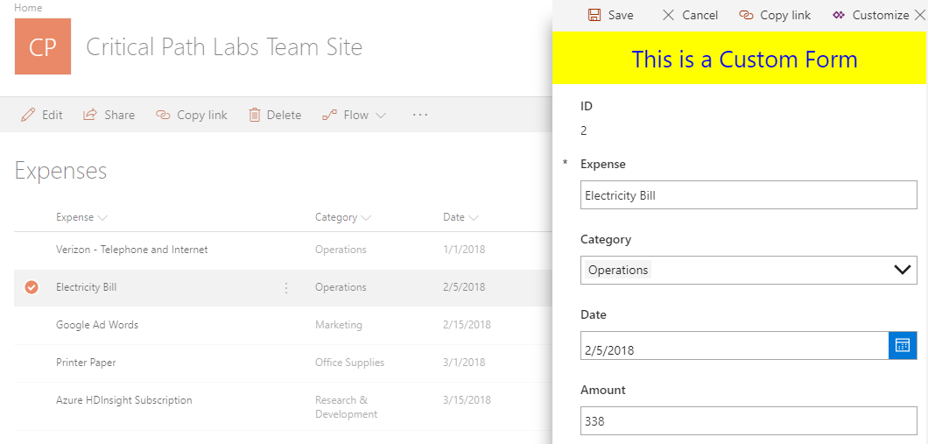
Editing Items using a Customized Form
Notes:
Once you activate the canvas app for a customized SharePoint list, you should be able to view and test the customized UI experience in SharePoint Online. You will see the customized form whenever you navigate into view mode or edit mode for an existing list item. You will also see the customized form when you execute the New Item command to add a new item to the SharePoint list.

Slide 28
Customizing SharePoint List Forms

Slide 29
Summary
Screen Design Guidelines
Displaying Repeating Data using Galleries
Using Table Functions to Filter and Sort Data
Updating Data using Edit Forms and Data Cards
Customizing SharePoint List Forms

